Slide 1
Natural Language Processing Specialization Siamese Networks
(2021 Deeplearning.ai)
YangXi’s Reading Notes

Slide 2
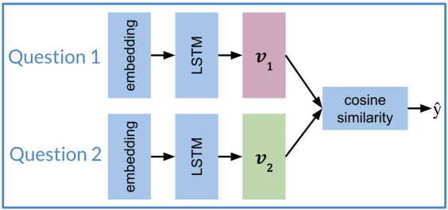
Siamese Networks – Introduction
Siamese Network is a NN with two identical subnetworks (sister networks), which are merged to product a final output (a similarity score)
On the right is a sample architecture
Not all Siamese Networks contain LSTM
Sub-networks share identical parameters
So, you need to train only one set of weights
Siamese network is used to identify similarity between things
Applications
Question Duplicates
“How old are you?” = “What is your age?”
“Where are you from?” ≠ “Where are you going?”
Handwritten checks: whether two signatures are the same
Queries: if a new query is similar to another old one

Slide 3
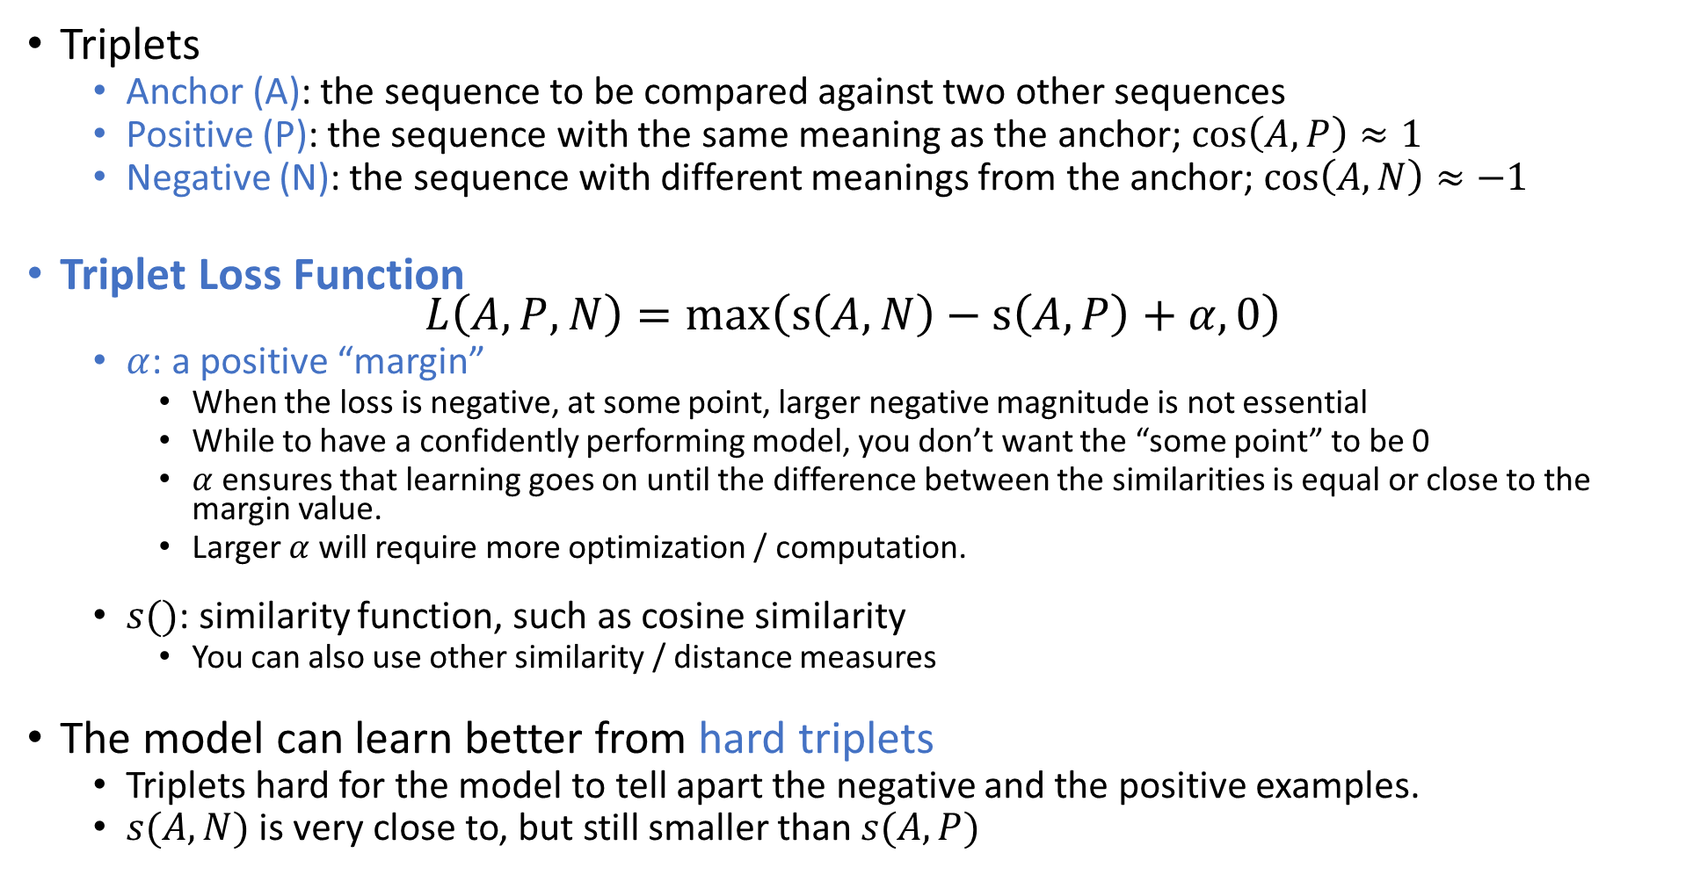
Triplet Loss
Triplets
Anchor (A): the sequence to be compared against two other sequences
Positive (P): the sequence with the same meaning as the anchor; $\cos\left(A,P\right)≈1$
Negative (N): the sequence with different meanings from the anchor; $\cos\left(A,N\right)≈−1$
Triplet Loss Function $L\left(A,P,N\right)=\max\left(s\left(A,N\right)−s\left(A,P\right)+α,0\right)$
$α$: a positive “margin”
When the loss is negative, at some point, larger negative magnitude is not essential
While to have a confidently performing model, you don’t want the “some point” to be 0
$α$ ensures that learning goes on until the difference between the similarities is equal or close to the margin value.
Larger $α$ will require more optimization / computation.
$s()$: similarity function, such as cosine similarity
You can also use other similarity / distance measures
The model can learn better from hard triplets
Triplets hard for the model to tell apart the negative and the positive examples.
$s(A,N)$ is very close to, but still smaller than $s(A,P)$

Slide 4
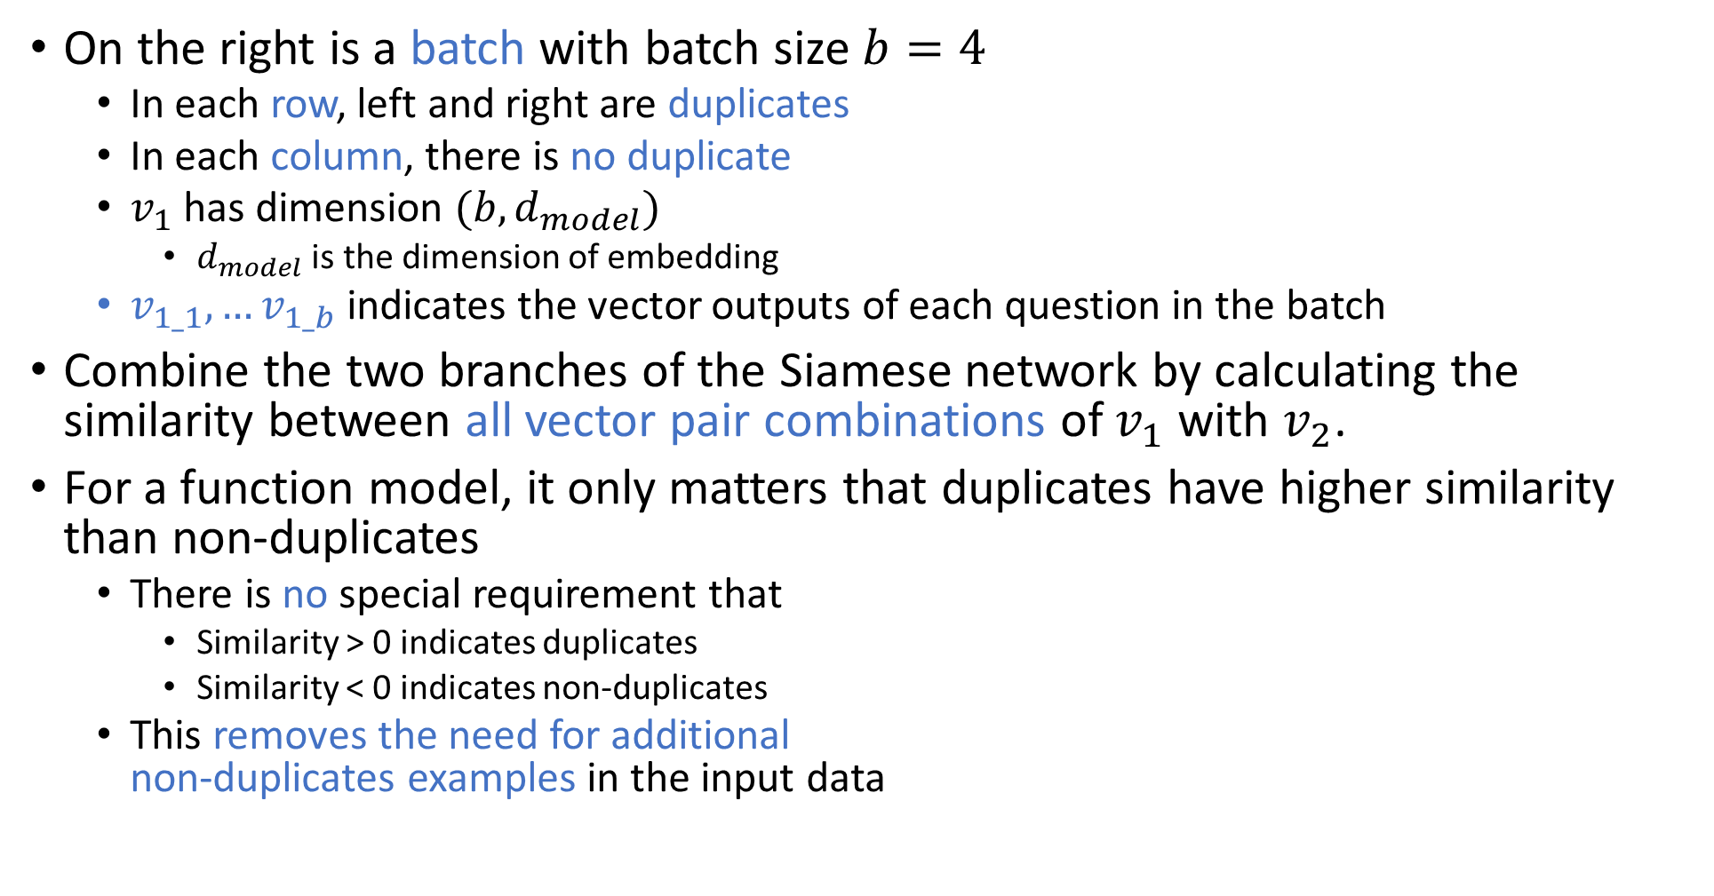
Create Batches
On the right is a batch with batch size $b=4$
In each row, left and right are duplicates
In each column, there is no duplicate
$v_{1}$ has dimension $(b, d_{model})$
$d_{model}$ is the dimension of embedding
$v_{1_1}, …v_{1_b}$ indicates the vector outputs of each question in the batch
Combine the two branches of the Siamese network by calculating the similarity between all vector pair combinations of $v_{1}$ with $v_{2}$.
For a function model, it only matters that duplicates have higher similarity than non-duplicates
There is no special requirement that
Similarity > 0 indicates duplicates
Similarity < 0 indicates non-duplicates
This removes the need for additional non-duplicates examples in the input data
What is your age? | How old are you?
Can you see me? | Are you seeing me?
Where are thou? | Where are you?
When is the game? | What time is the game?

Slide 5
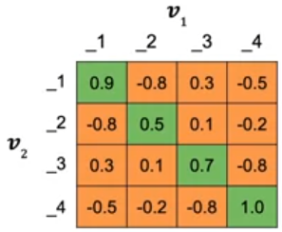
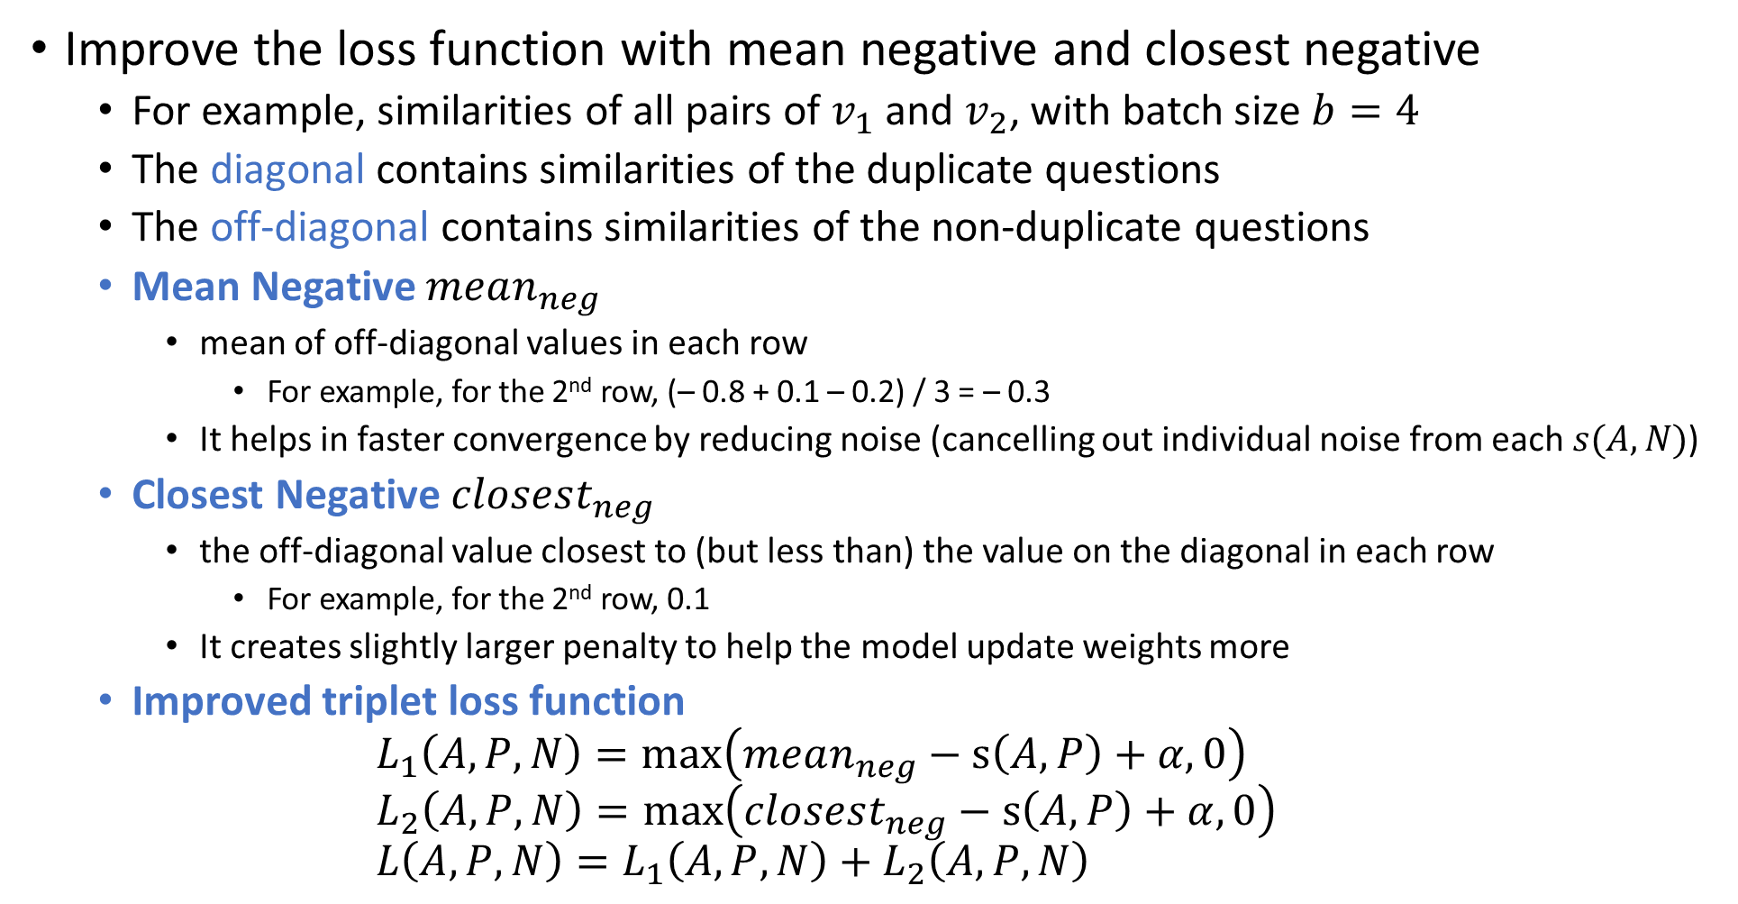
Hard Negative Mining
Improve the loss function with mean negative and closest negative
For example, similarities of all pairs of $v_{1}$ and $v_{2}$, with batch size $b=4$
The diagonal contains similarities of the duplicate questions
The off-diagonal contains similarities of the non-duplicate questions
Mean Negative $mean_{neg}$
mean of off-diagonal values in each row
For example, for the 2nd row, (– 0.8 + 0.1 – 0.2) / 3 = – 0.3
It helps in faster convergence by reducing noise (cancelling out individual noise from each $s(A,N)$)
Closest Negative $closest_{neg}$
the off-diagonal value closest to (but less than) the value on the diagonal in each row
For example, for the 2nd row, 0.1
It creates slightly larger penalty to help the model update weights more
Improved triplet loss function $L_{1}\left(A,P,N\right)=\max\left(mean_{neg}−s\left(A,P\right)+α,0\right)$ $L_{2}\left(A,P,N\right)=\max\left(closest_{neg}−s\left(A,P\right)+α,0\right)$ $L\left(A,P,N\right)=L_{1}\left(A,P,N\right)+L_{2}\left(A,P,N\right)$

Slide 6
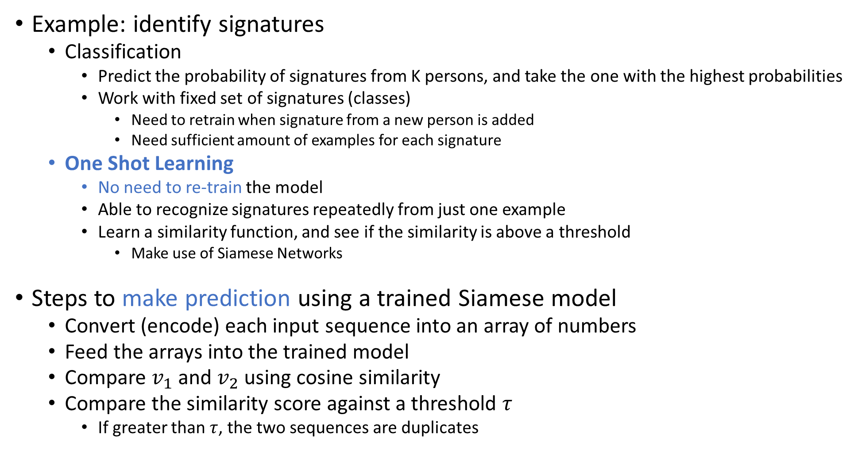
One Shot Learning
Example: identify signatures
Classification
Predict the probability of signatures from K persons, and take the one with the highest probabilities
Work with fixed set of signatures (classes)
Need to retrain when signature from a new person is added
Need sufficient amount of examples for each signature
One Shot Learning
No need to re-train the model
Able to recognize signatures repeatedly from just one example
Learn a similarity function, and see if the similarity is above a threshold
Make use of Siamese Networks
Steps to make prediction using a trained Siamese model
Convert (encode) each input sequence into an array of numbers
Feed the arrays into the trained model
Compare $v_{1}$ and $v_{2}$ using cosine similarity
Compare the similarity score against a threshold $τ$
If greater than $τ$, the two sequences are duplicates

